Slide 1


SUNSTONE
“ Calendar scheduler application”
Task - 4

Slide 2

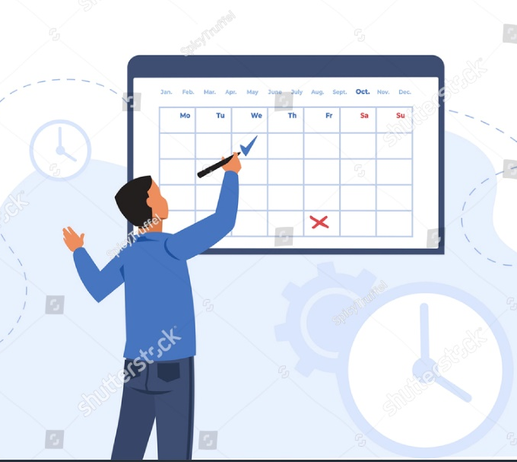
SUNSTONE
Calendar scheduler application
The Calendar Scheduler Application is a versatile tool designed for effective time management, catering to the needs of individuals and organizations. With an intuitive and user-friendly interface, it offers features such as customizable calendar views, collaborative scheduling, task management, and seamless integration with external calendars. The application ensures timely notifications and reminders, fostering productivity and reducing the risk of missed appointments. Security measures, including encryption and secure data transmission, prioritize user privacy.

Slide 3
SUNSTONE
Task 4 : Dynamic Frontend
Integrate the APIs to frontend to ensure the dynamic feature of website
Point base API to the severs base URL
Design API calls for each element
Handle errors in the output
Render output of API’S to different low level components
Secure content of post API’S
●
●
●
Evaluation Metric:
100% Completion of the above tasks
Learning outcome
Developing complicated UI using HTML components
Using props drilling and context to pass variables
Getting familiar with different type of api calls
Handling different input data

Slide 4
SUNSTONE
Step-Wise Description
1.Define Scope and Tech Stack
Identify key features: date/time, reminders, recurring events.
Choose a scalable tech stack for efficient development.
2. UI/UX and Frontend:
Design an intuitive, responsive interface.
Develop frontend for seamless user interaction.
3. Functionality and Integration:
Enable easy date/time selection and recurring events.
Integrate with address book for efficient location input.
4.Task Organization:
Implement task prioritization, inspired by a shopping cart concept.
Allow users to categorize and label events for better organization.
5.Testing, Deployment, and Support:
Conduct thorough testing for functionality and security.
Deploy on a reliable platform and provide user support.
Summary of your task
The project aims to develop a calendar scheduler application, minimizing manual scheduling efforts. It will efficiently manage appointments, tasks, and events while providing details on user schedules, ensuring seamless organization.

Slide 5
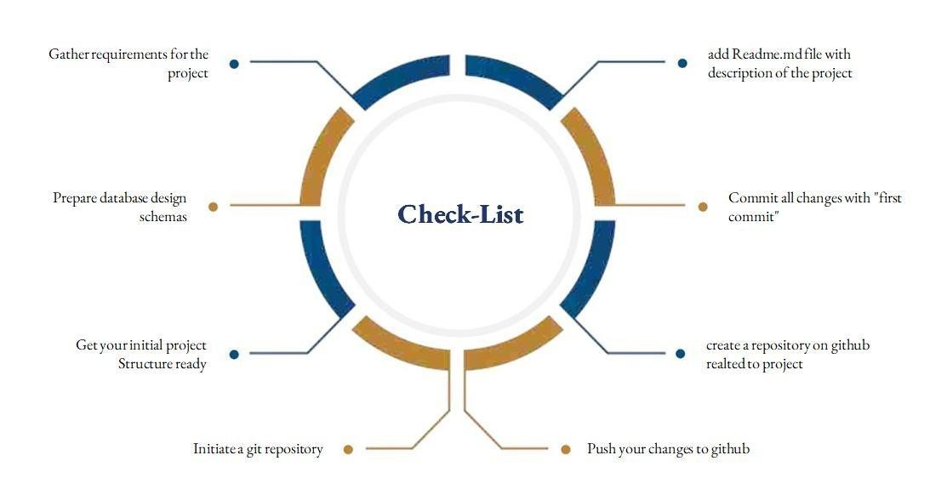
SUNSTONE
Assesment Parameter

Slide 6
Submission Github
SUNSTONE
https://github.com/jayashri-18/NM--AIT--GROUP4.git

Slide 7


SUNSTONE

